Slide 1
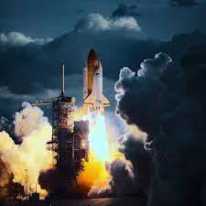
Data Science Capstone Project: SPACEX
By
Sayeda Fatima

Slide 2



Outline
Executive Summary
Introduction
Methodology
Results
Conclusion
Appendix

Slide 3

Summary of Methodologies
Data Collection was carried out through SPACE X Rest API
Data Wrangling employed One-Hot Coding
Exploratory Data Analysis (EDA) using SQL and Visualizations
Interactive Visual Analytics using Folium and Plotly-Dash
Predictive Analysis using Machine Learning Algorithms
Summary of Results
Data Analysis revealed relationships between variables and conditions determining success or failure
Interactive Visualizations achived
Best Predictive Modelling is Machine Learning

Slide 4


Project Background and Context
The aim of this project is to predict success or failure of Falcon 9’s landings. SpaceX’s website records Falcon 9 rocket’s launch cost as $62 million in contrast to $165 million by other providers. The price difference is due to SpaceX’s ability to reuse its first stage. Hence, by predicting success of landing, the cost of launch can be estimated. Consequently, this information can be useful for other providers competing with SpaceX for rocket launches.
Problems requiring resolution
What are the main characteristics of a successful or failed landing?
What are the impacts of variable relationships on landing success or failure?
What are the conditions which will facilitate SpaceX in acquiring best landing success rates?

Slide 5


Data Collection
SPACE X Rest API
Data Wrangling
Unwanted Column Drop
One-Hot Coding
Exploratory Data Analysis (EDA)
Visualizations
SQL
Interactive Visual Analytics
Folium
Plotly Dash
Predictive Analysis
Classification Models

Slide 6
Data Collection Methodology
The following methods have been employed:
API Data Extraction
Importing json file from: "https://api.spacexdata.com/v4/launches/past"
Pandas Data Transformation
Importing selected columns from
Data Filteration
Filtering ‘Falcon9’ rows
json data into pandas dataframe
“Payload” Missing Value replacement with average values

Slide 7
Data Wrangling Methodology
The following methods have been employed:
Data Analysis
Task 1: Calculating “Number of Launches“
Data Upload
“csv” conversion to Dataframe
Task 2: Calculating “Orbit Occurrences“

Slide 8
EDA & IVA Methodology
Folium, an interactive leaflet map
The following folium methodology was employed:
Plotly Dash,
an interactive framework for building ML & data science web apps
The following plotly dash method was employed:
Reverse Geo-coding to find State names with Launch Site concentration
Marking of Launch sites
Marking of Successful/Failed launches
Marking distance between launch sites and proximities
Creation of App Layout
Creation of Callback Functions for Pie Chart
Creation of Callback Functions for Scatter Chart with Slider
The following methods have been employed:

Slide 9
Predictive Analysis Methodology
Decision Trees
which employs a top-down approach to a dataset and tries to group data on the basis of dissimilarity till a certain degree of similarity is attained
K-Nearest Neighbors (KNN)
which classifies a given dataset elements on the basis of similarity or closeness
Support Vector Machines (SVM)
which finds the best hyperplane to divide a given dataset into two classes
Logistic Regression
which estimates the probability of an event occurring, like yes or no, based on selected dataset of independent variables.
The following methods have been employed:

Slide 10
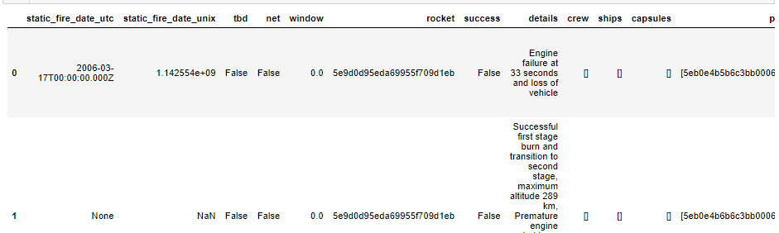
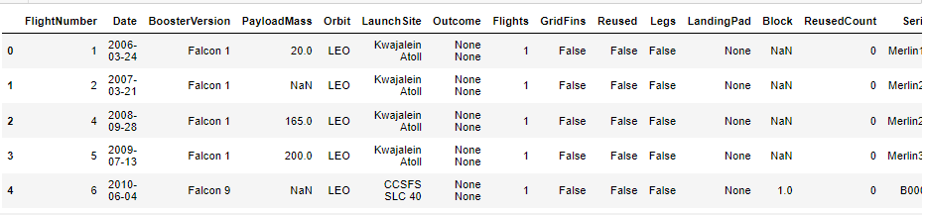
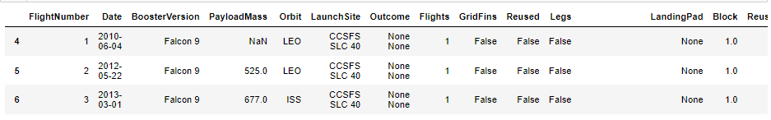
Data Collection Results
API Data Extraction
Pandas Data Transformation
Data Filtration

Slide 11
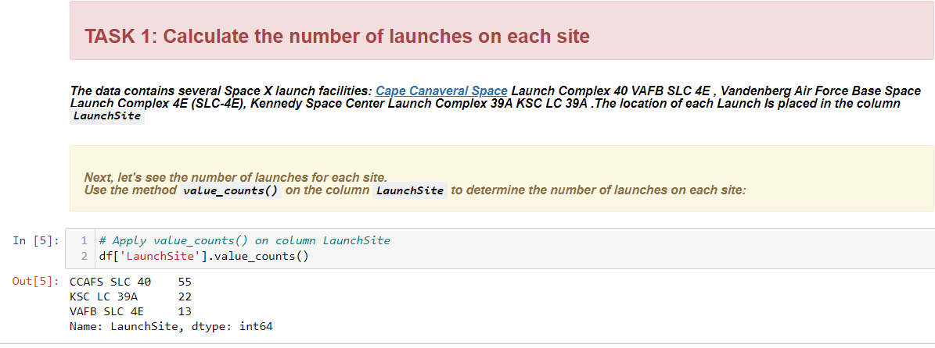
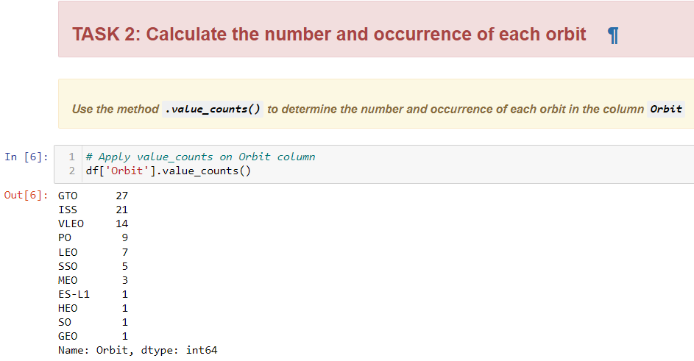
Data Wrangling Results1
Number of Orbital Occurances
Orbit “GTO” exhibited
Number of Launches
Maximum launches
Maximum Occurances
From “CCAFS SLC 40”

Slide 12
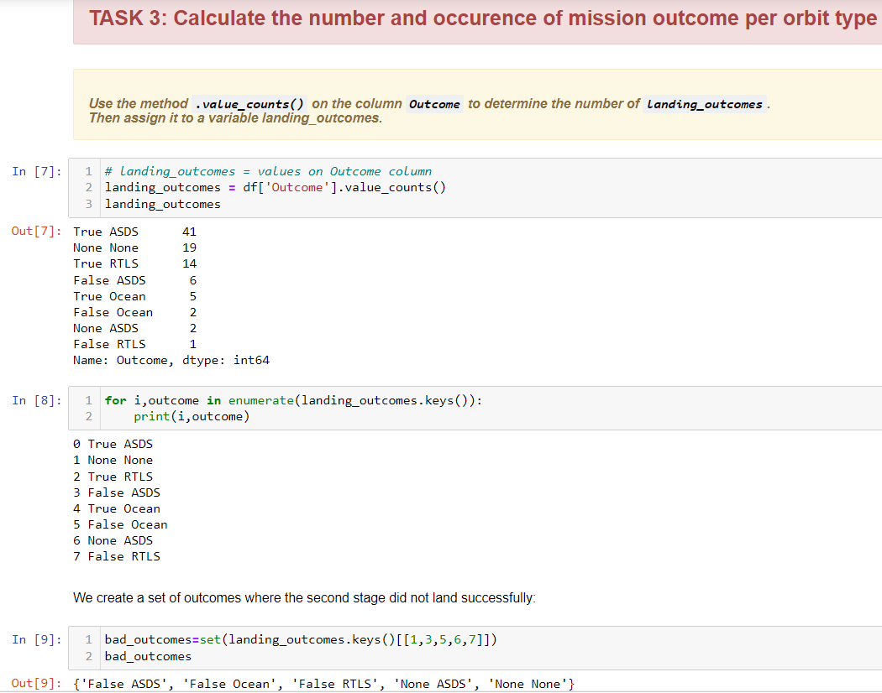
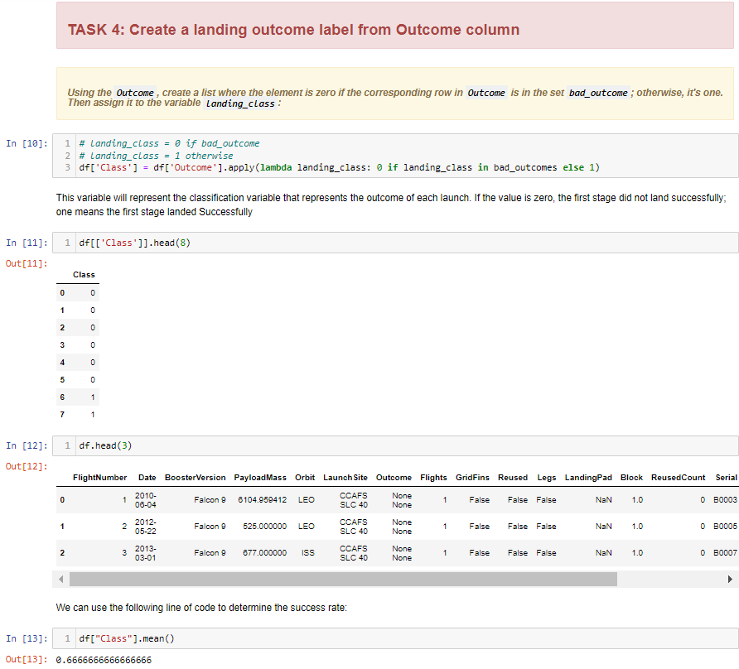
Data Wrangling Results 2
60 True Outcomes
Mission Outcome Occurrences
New Column Creation for Labelling
Copied “Outcomes” Column
to New “Class” Column

Slide 13
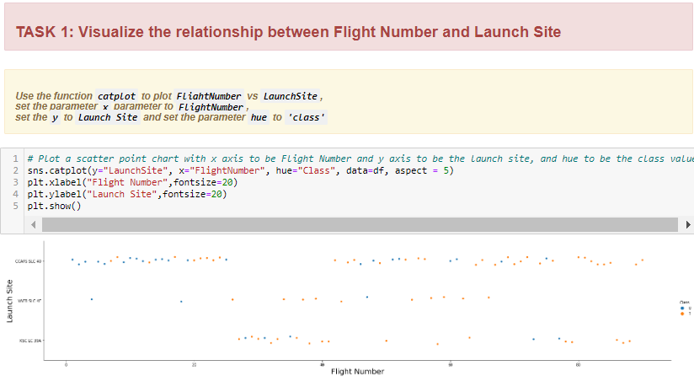
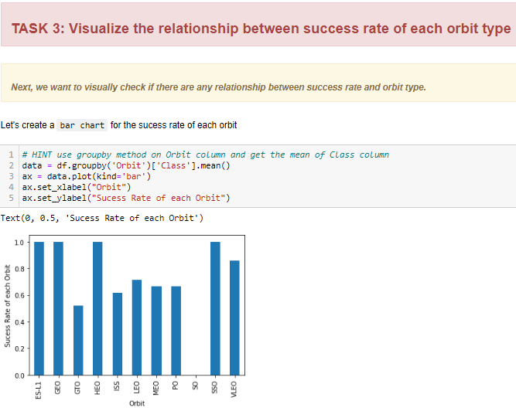
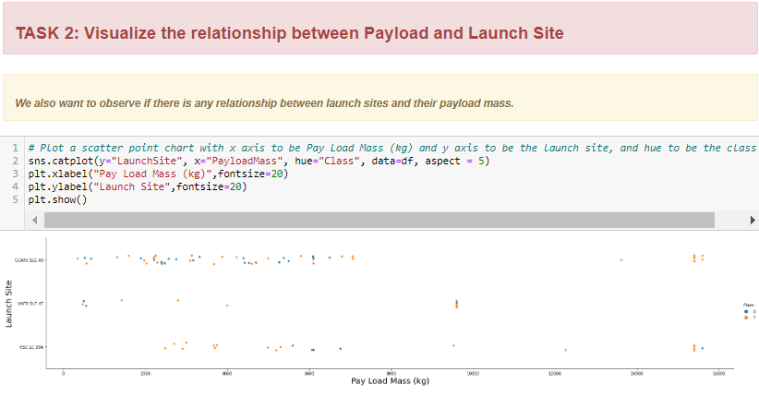
EDA Interactive Visuals Results 1
Interpretation
Task 1: Increase in success rate for each site
Task 2: Landing Failures seem to be related to excessive payload
Task 3: Best success rate was exhibited by “ES-L1”, “GEO”, “HEO” & “SSO”

Slide 14
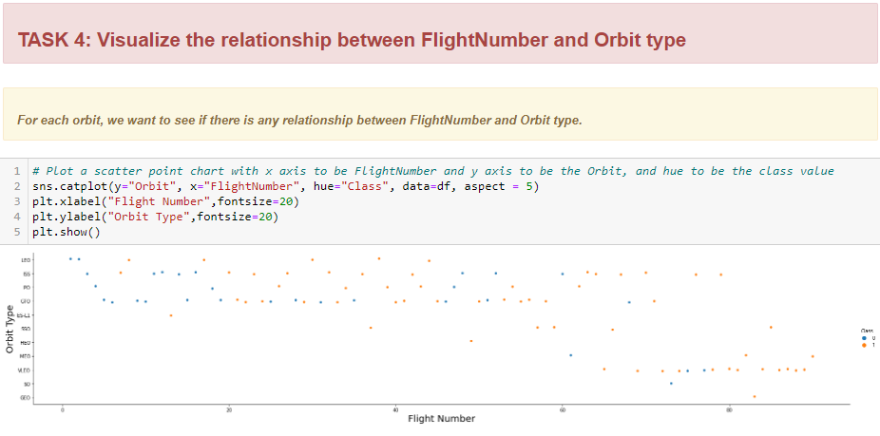
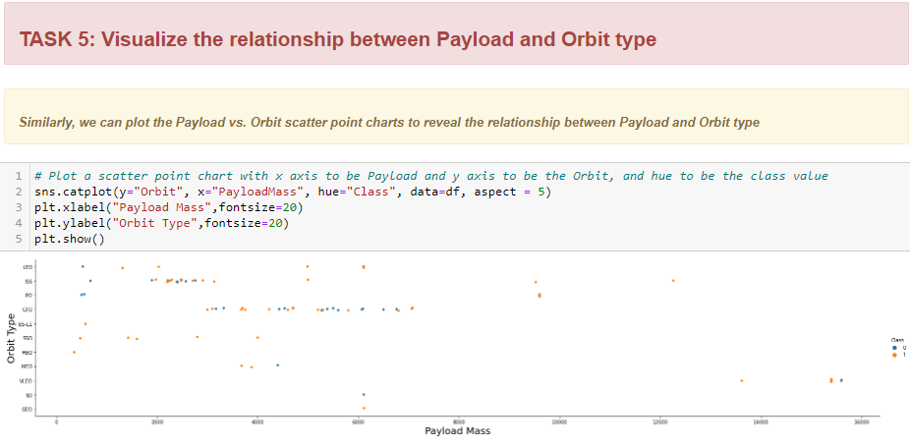
EDA Interactive Visuals Results 2
Task 4
There is an increase in success rate
with number of flights
Task 5
Increased “Payload Mass” increases success
decreasing “Payload Mass” increases
success rate in some Orbits like “ GTO ”
rate in some Orbits like “LEO” while

Slide 15
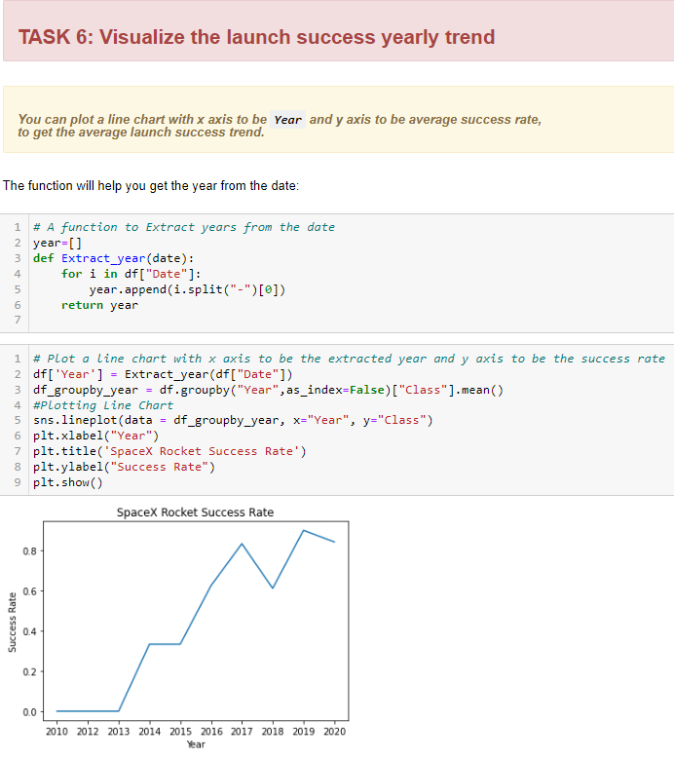
EDA Interactive Visuals Results 3
Tasks 6
There is a general increase in success rate since “2013”

Slide 16
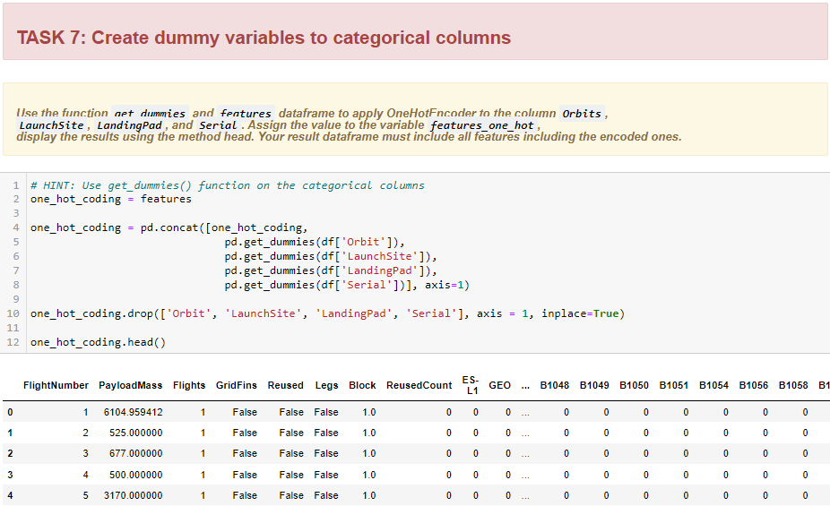
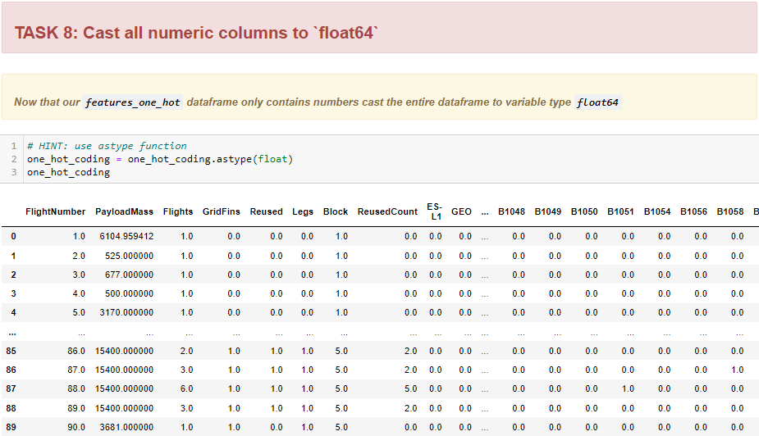
EDA Interactive Visuals Results 4
Task 7 & 8
“One Hot Coding” transposed
features columns as float

Slide 17
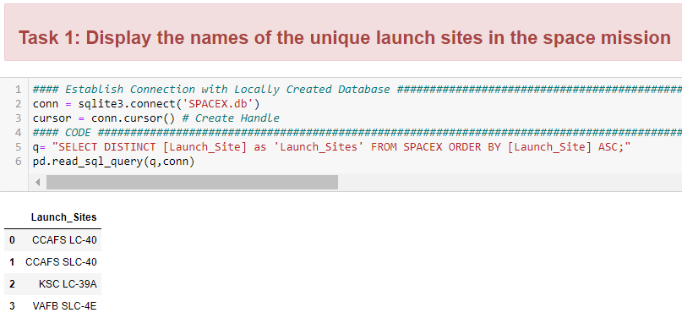
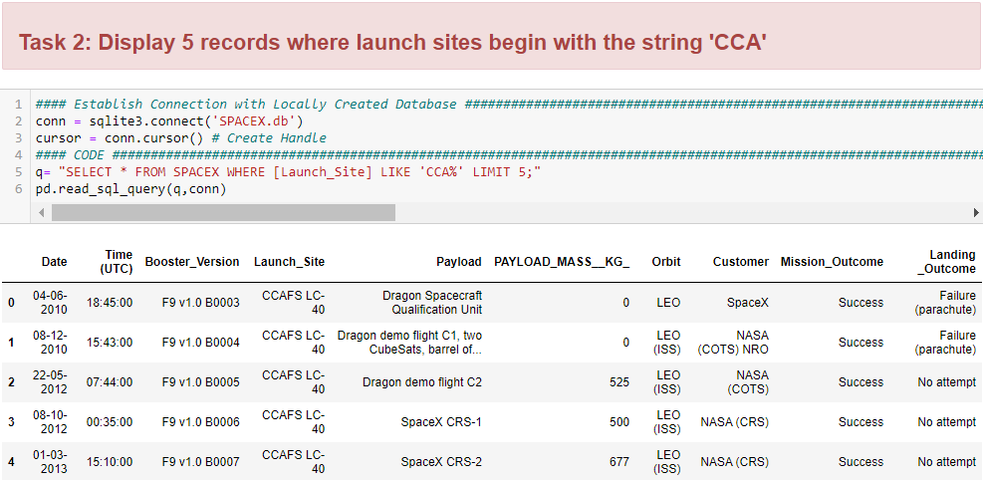
EDAwith SQL 1
Local SQL Database Creation achieved from csv
Tasks
1) 4 Unique Launch Sites were found
2) Records of Launch Sites Like ‘CCA’ achieved
Bonus Task

Slide 18
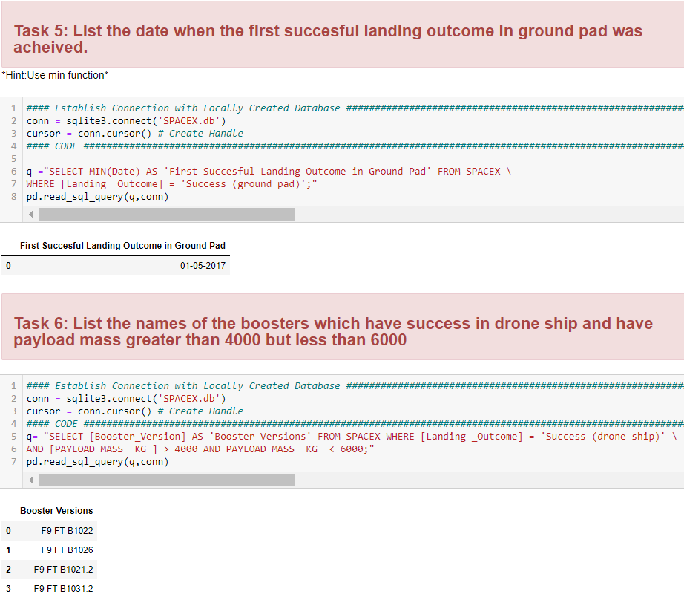
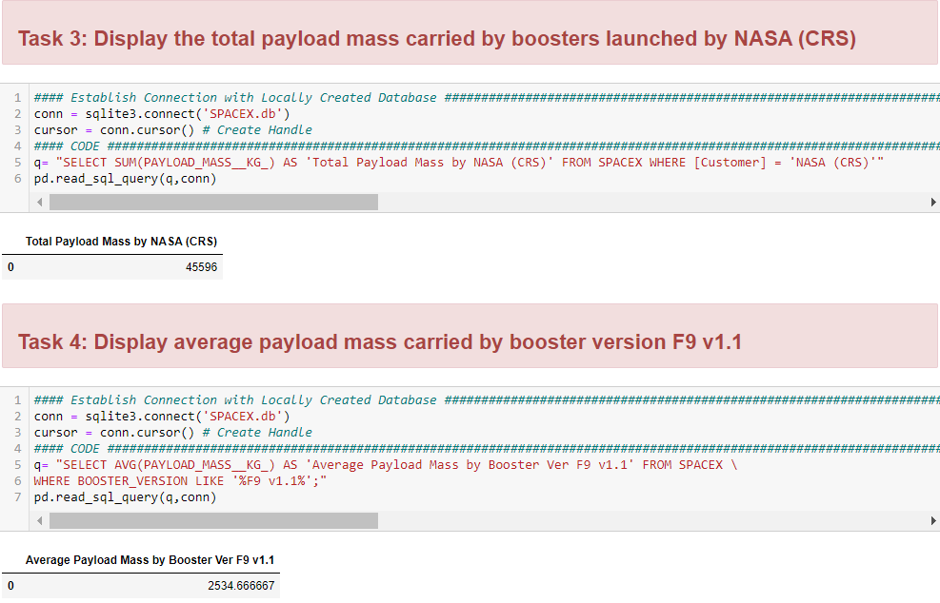
EDAwith SQL Results 2
Tasks
3) Total “Payload Mass” carried by Boosters is 45596
4) Average “Payload Mass” by Booster F9 v1.1 is 2535
5) First Successful Landing was in 2017
6) 4 successful Boosters between “Payload Mass” 4000 and 600

Slide 19
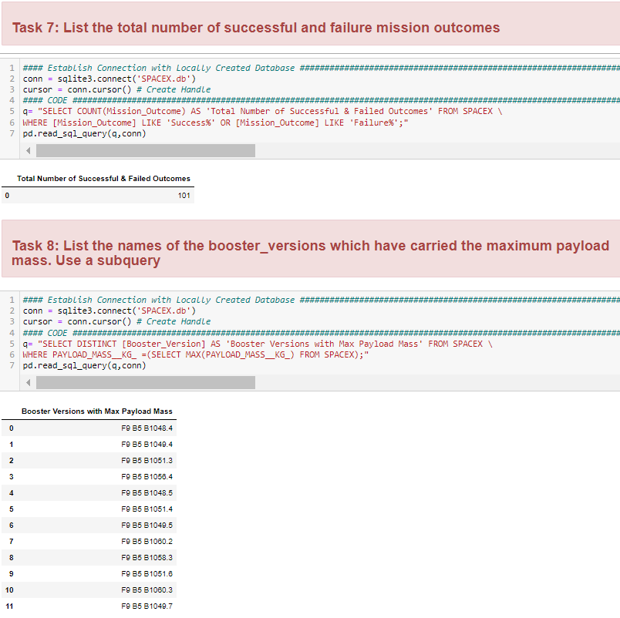
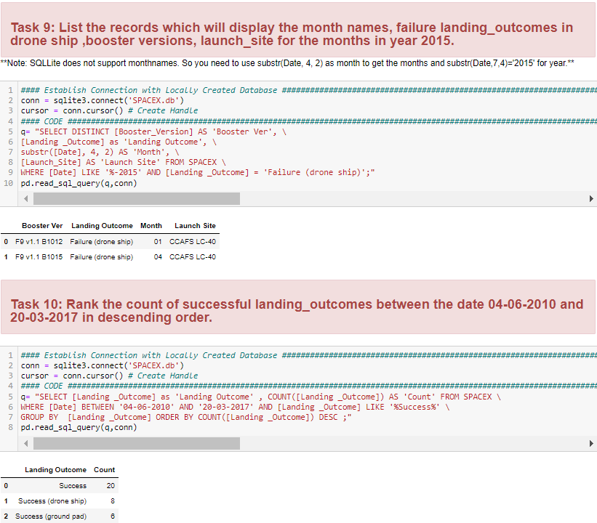
EDA with SQL Results 3
Tasks
7) Total Successful & Failed Outcomes are 101
8) Sub-query returned 11 Boosters with Max “Payload Mass”
9) “Year 2015” Analysis displayed 2 failed landing outcomes
10) 34 Successful Outcomes between “2010-17”

Slide 20
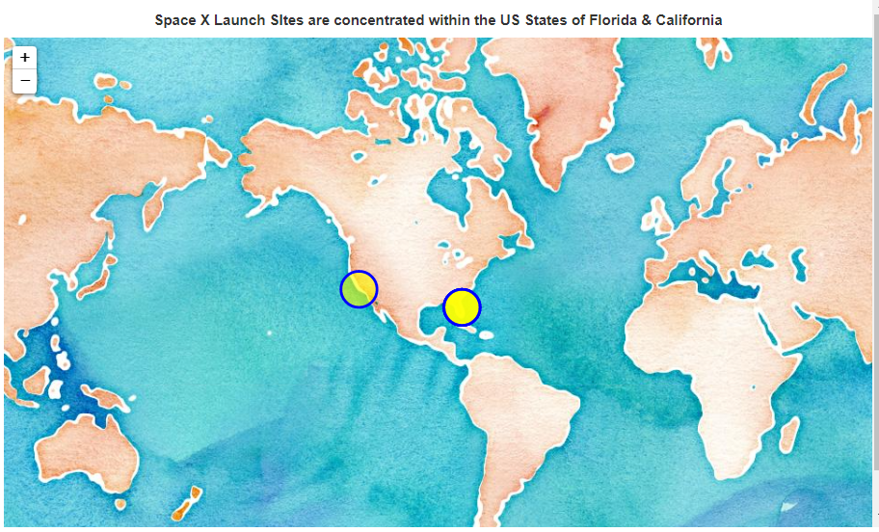
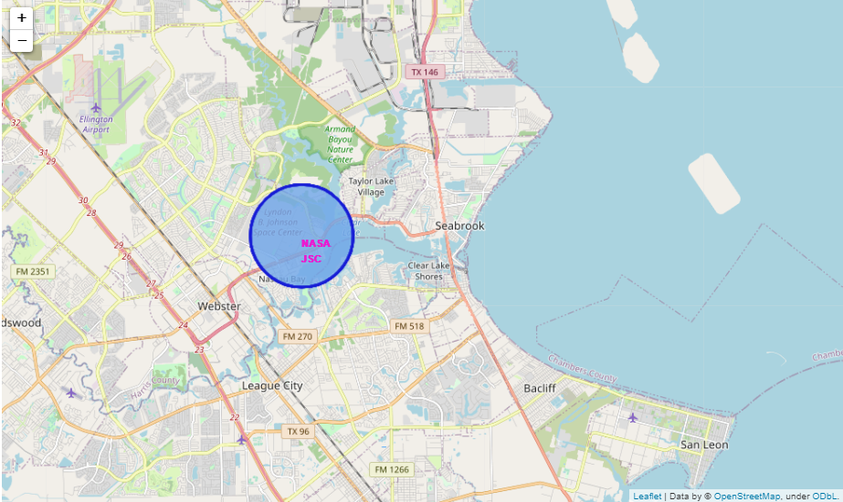
Interactive Visual Analysis
Folium Results 1
Bonus Task: Displaying Concentration of Space X Launch Sites
Task 1: Displaying 'NASA Johnson Space Center'

Slide 21
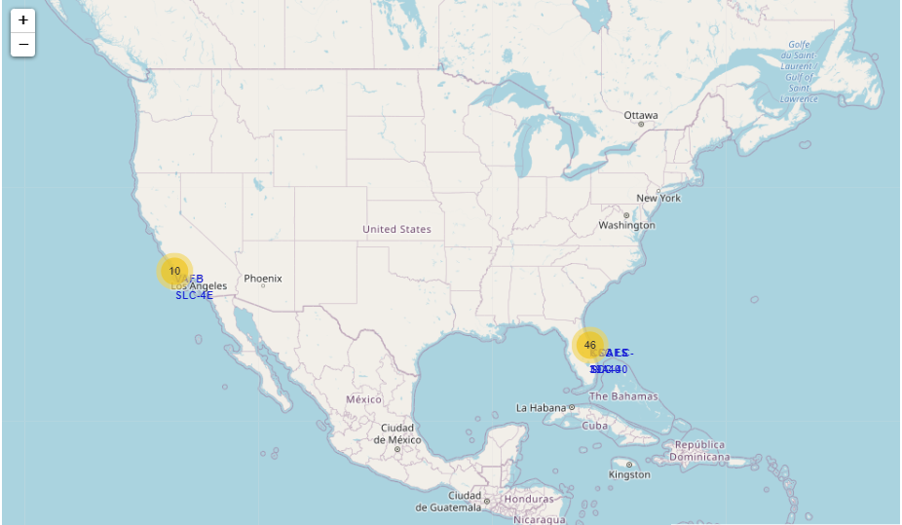
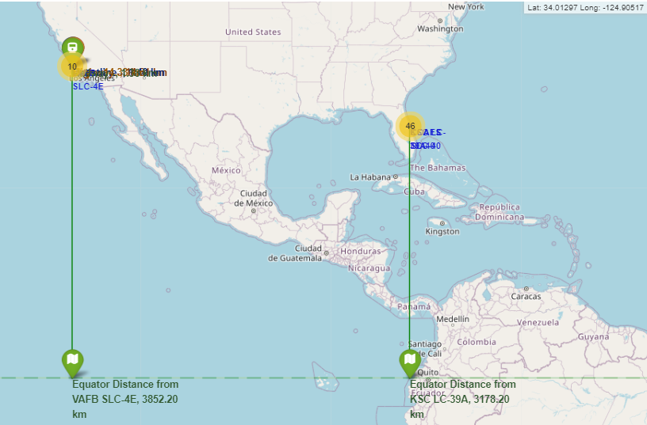
Interactive Visual Analysis
Folium Results 2
Task 2: Displaying Successful/Failed Launches
Task 3: Displaying Distances between Launch Sites to its Proximities

Slide 22
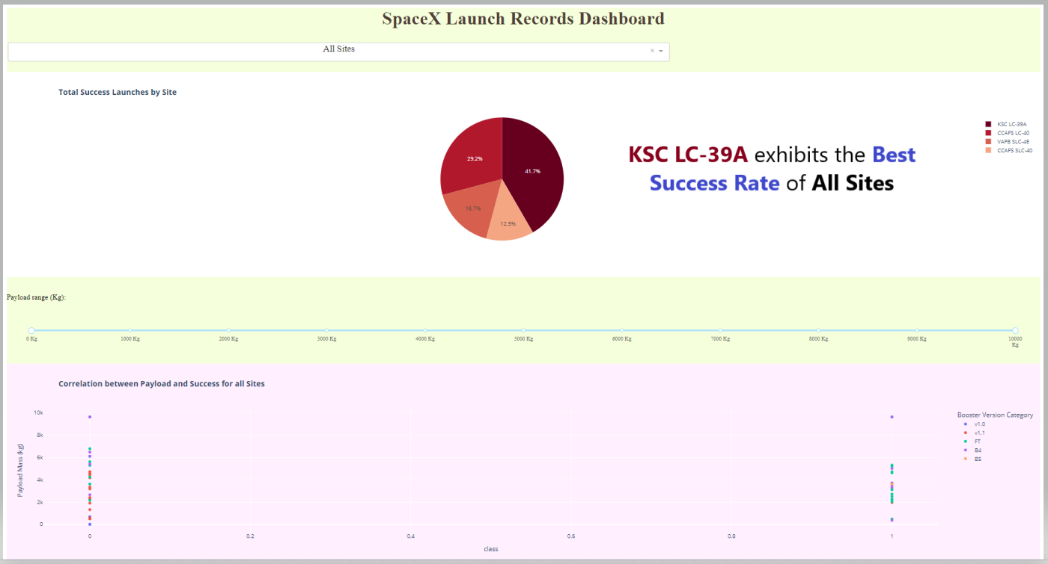
Interactive Visual Analysis: Plotly Dash All Sites Results

Slide 23
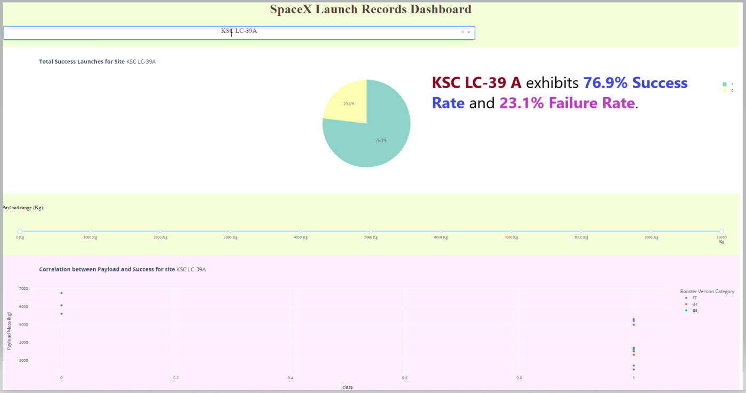
Interactive Visual Analysis: Plotly Dash KSC LC-39 A Site Results

Slide 24
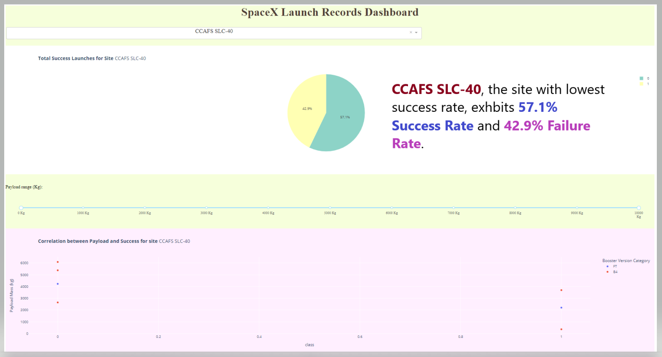
Interactive Visual Analysis: Plotly Dash CCAFS SLC-40 Site Results

Slide 25
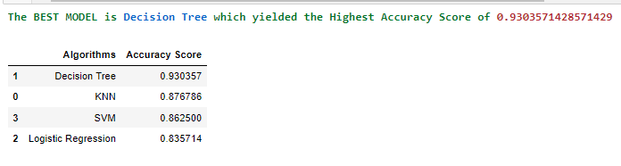
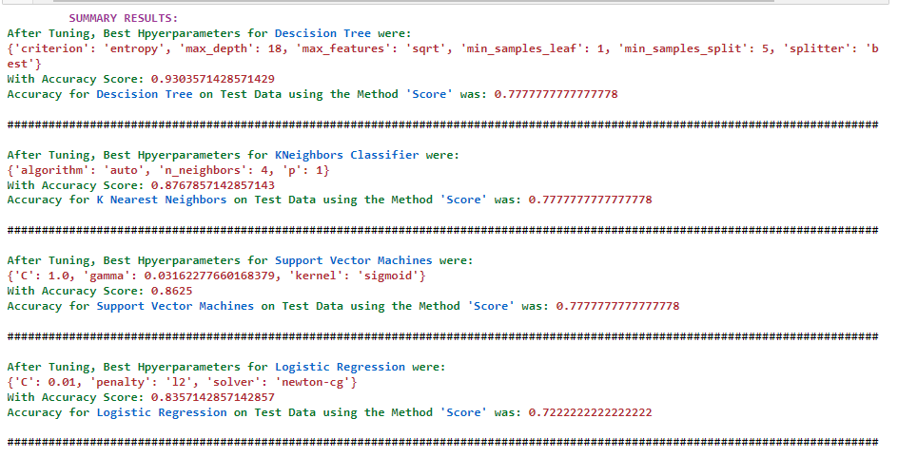
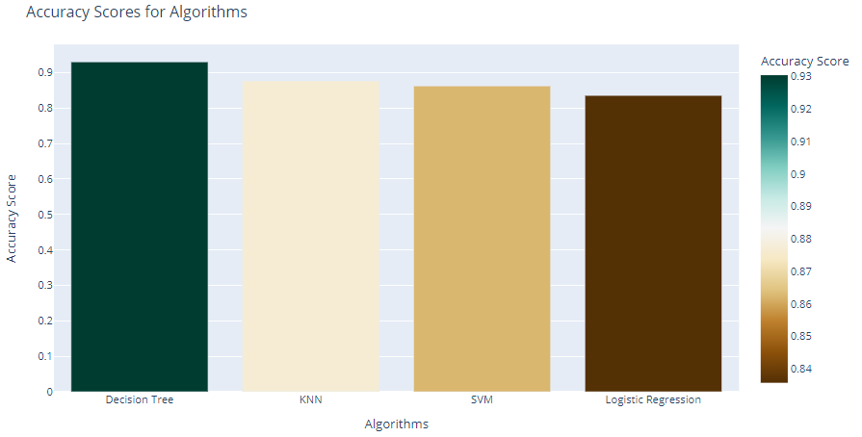
Predictive Analysis Results
With the Highest Accuracy Score on
Train Data, Decision Tree is the winner among all models.

Slide 26
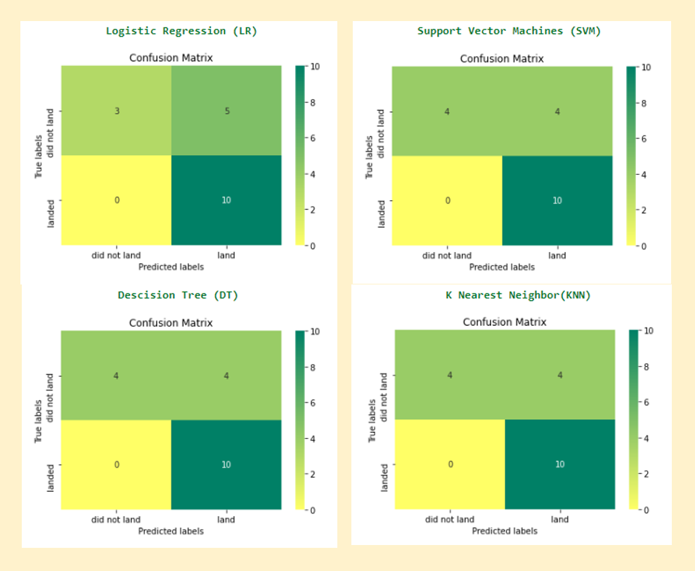
Predictive Analysis Results
After tuning for best hyper-parameters, accuracy on Test Data using method score was the same for all models except Logistic Regression (LR). This is why, the confusion matrix for LR is different while for the rest it is the same

Slide 27
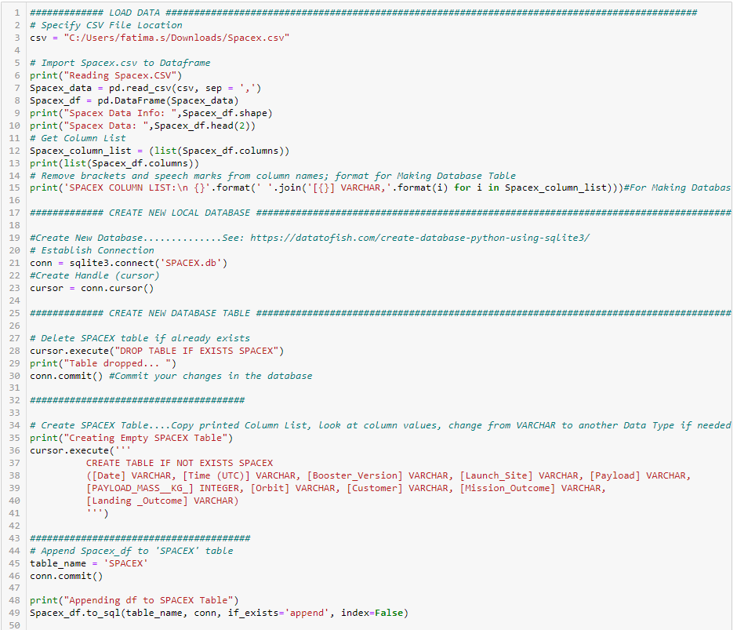
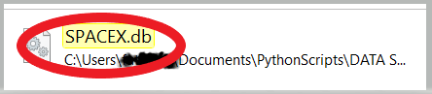
Application of Creativity Beyond Template
Exploratory Data Analysis
SQL: Local Database Creation was achieved for subsequent SQL EDA

Slide 28
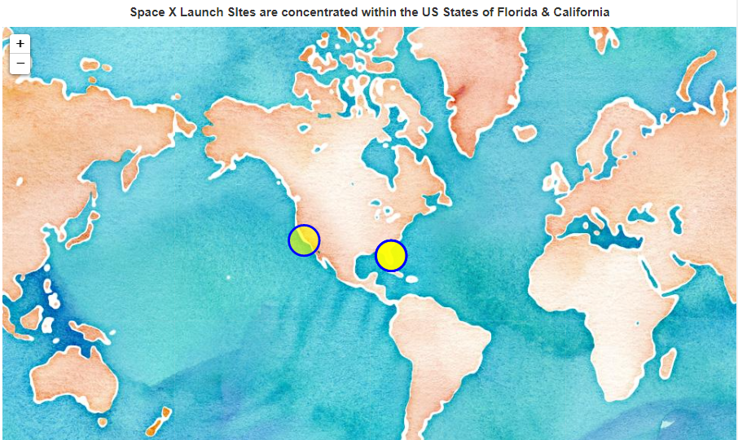
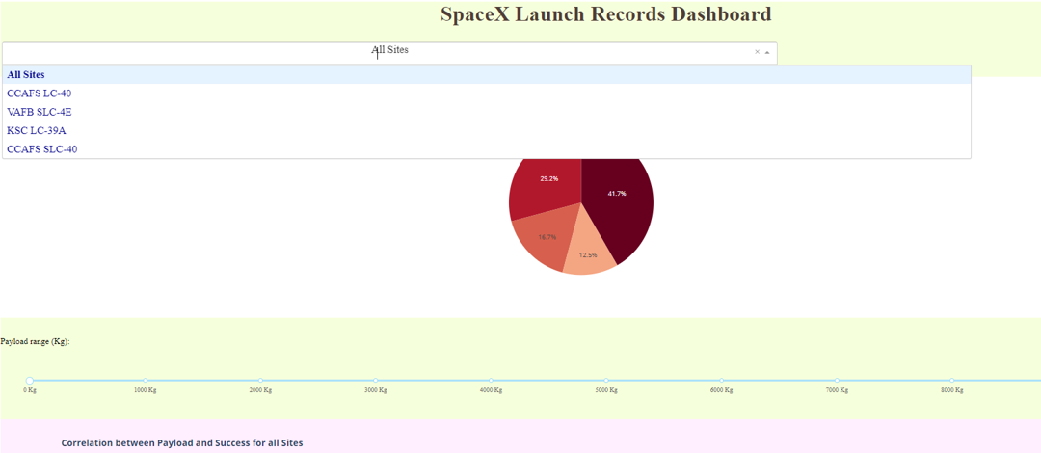
Application of Creativity Beyond Template
Interactive Visual Analytics
Folium: Reverse Geo-coding to find State names with Launch Site concentration
Plotly Dash: Colored dropdown list, app background coloring & pie chart color change

Slide 29
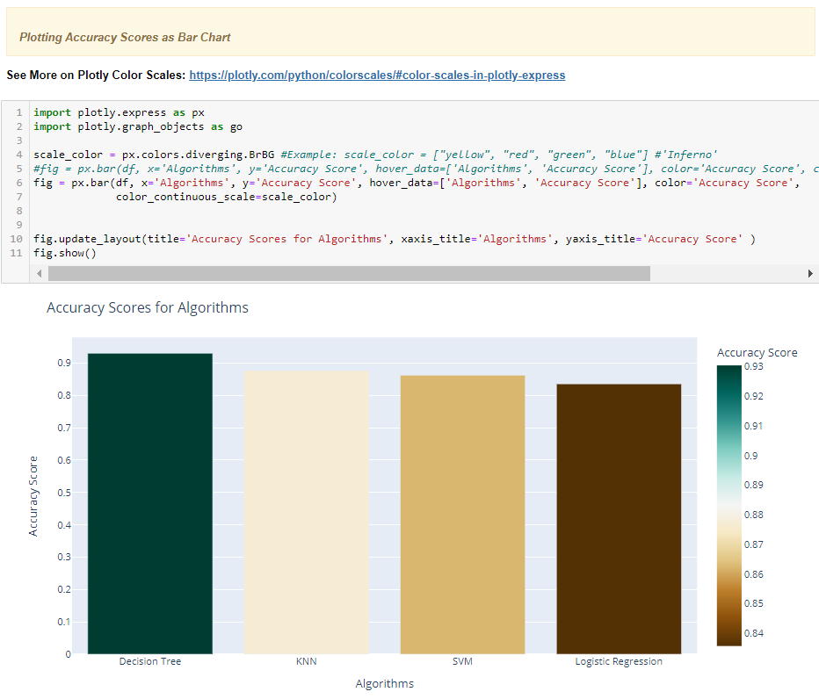
Application of Creativity Beyond Template
Predictive Analysis:
Plotting of Accuracy Scores as Bar Chart to furnish visual insight of modelling accuracy results

Slide 30

Mission success is influenced by factors like, orbit, launch site and number of previous launches since they furnish insight to ensure future success
Most successful launch site is “KCS LC-39A” but underlying factors cannot be identified with current data
Orbits with best success rate are GEO, HEO, SSO, ES-L1
Depending on particular orbits, increase or decrease of Payload Mass seems to be a significant factor
Predictive Analysis using Machine Learning can be best achieved by Decision Tree Modelling due to its high accuracy score with training data

Slide 31

Falcon 9’s success may go beyond identified factors and may be related to other variables like engine composition, material, etc.
The success of best launch sites may be related to weather conditions or atmospheric variables which needs to be explored further
Cost of successful orbital landing can be reduced by multiple relaunches

Slide 32


